Slide 1
Digital Music Store Analysis

Slide 2
Objective:
The objective of this data analysis project is to analyze the performance and trends of a digital music store. This includes examining sales data, customer behavior, popular genres and artists, and identifying opportunities for growth and improvement within the store.

Slide 3
KPI’s:
Who is the senior most employee based on job title?
Which countries have the most Invoices?
What are top 3 values of total invoice?
Which city has the best customers? We would like to throw a promotional Music Festival in the city we made the most money. Write a query that returns one city that has the highest sum of invoice totals. Return both the city name and sum of all invoice totals.
Who is the best customer? The customer who has spent the most money will be declared the best customer. Write a query that returns the person who has spent the most money.
Write query to return the email, first name, last name and Genre of all Rock Music listeners. Return your list ordered alphabetically by email starting with A.

Slide 4
Let's invite the artists who have written the most rock music in our dataset. Write a query that returns the Artist name and total track count of the top 10 rock bands.
Return all the track names that have a song length longer than the average song length. Return the Name and Milliseconds for each track. Order by the song length with the longest songs listed first.
Find how much amount spent by each customer on artists? Write a query to return customer name, artist name and total spent
We want to find out the most popular music Genre for each country. We determine the most popular genre as the genre . with the highest amount of purchases. Write a query that returns each country along with the top Genre. For countries where the maximum number of purchases is shared return all Genres.
Write a query that returns the country along with the top customer and how much they spent. Write a query that determines the customer that has spent the most on music for each country.

Slide 5
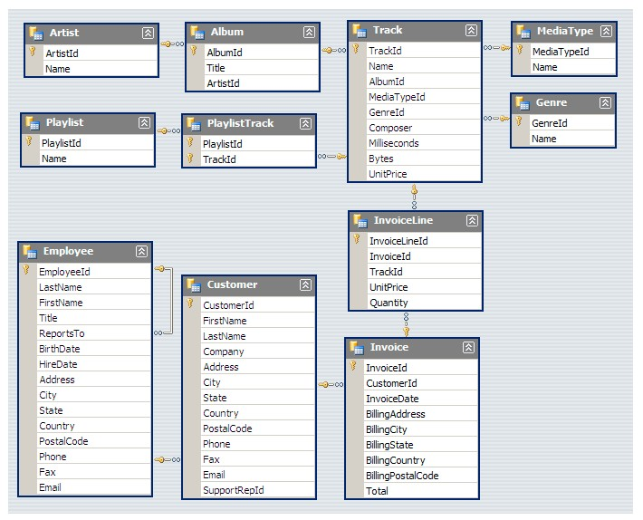
Schema:

Slide 6
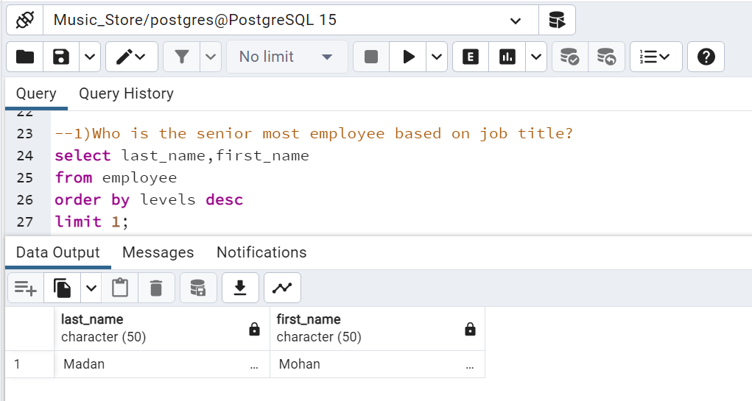

Slide 7
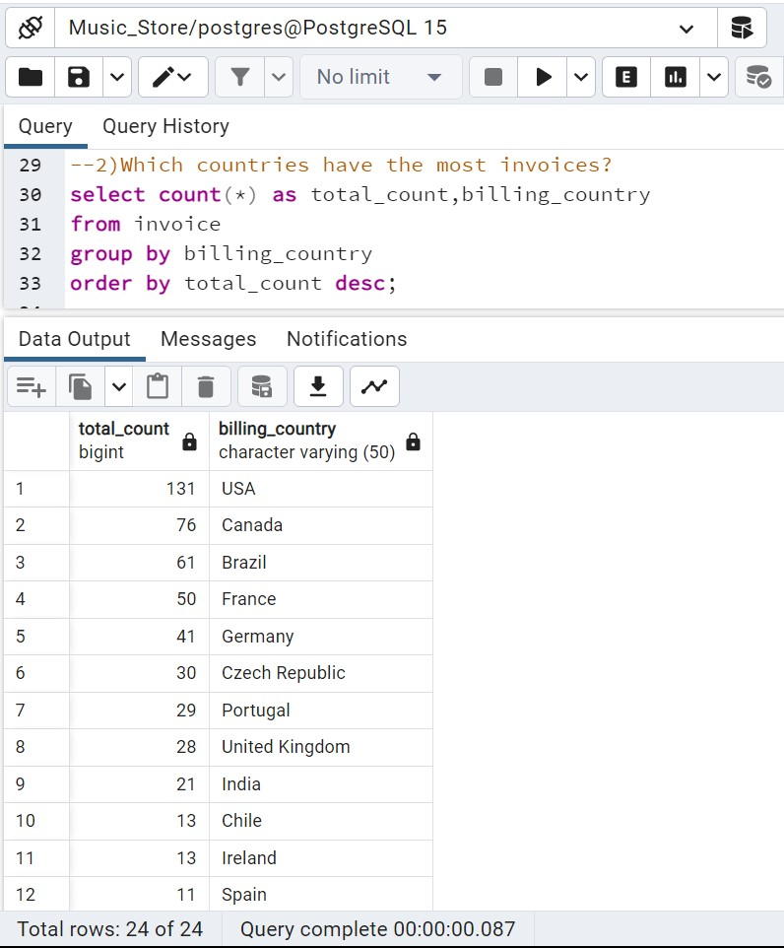

Slide 8
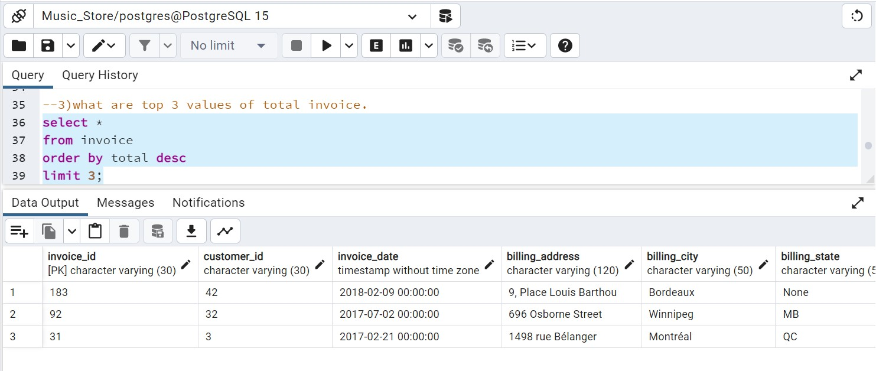

Slide 9
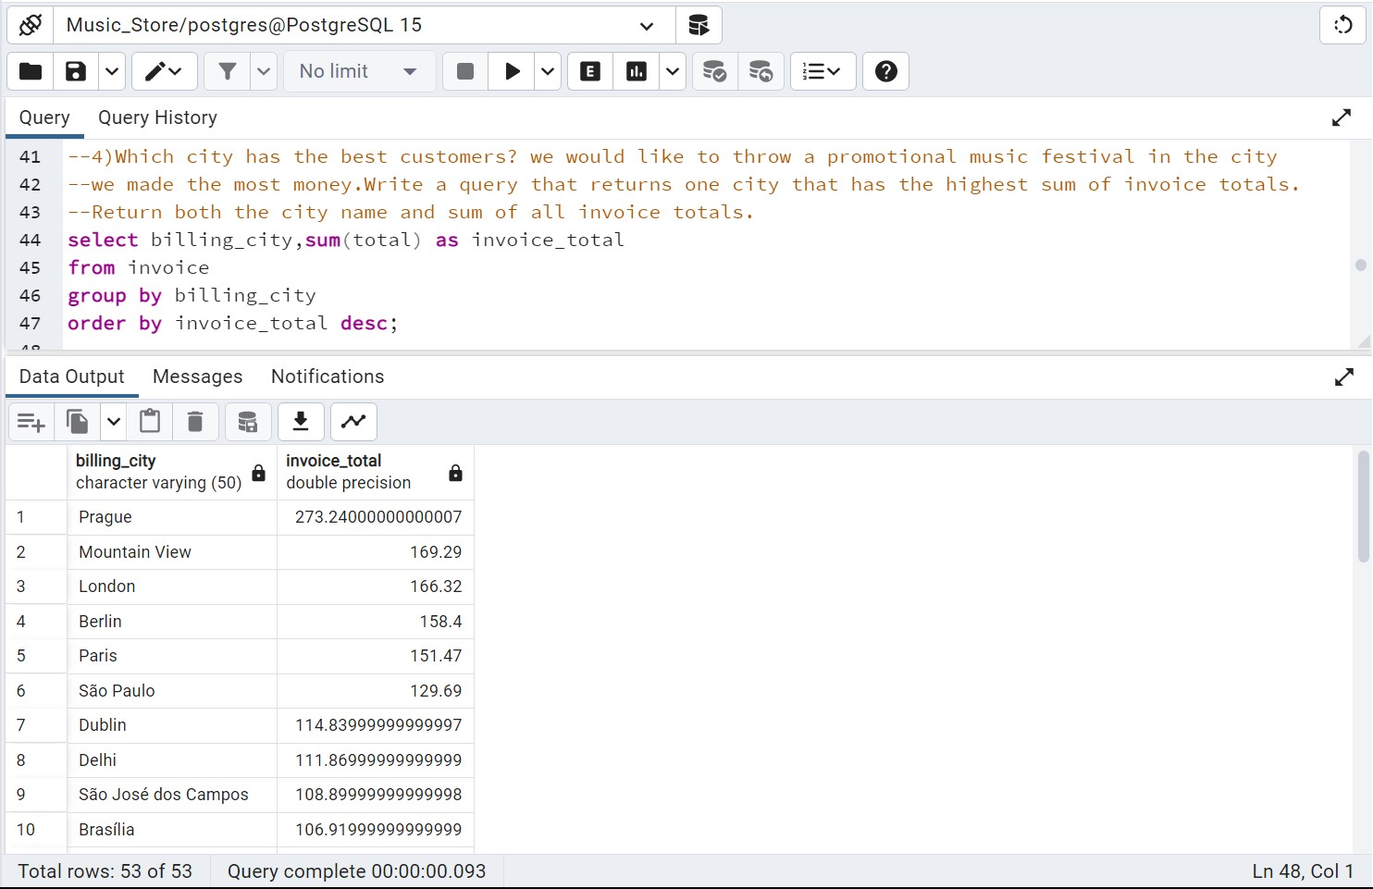

Slide 10
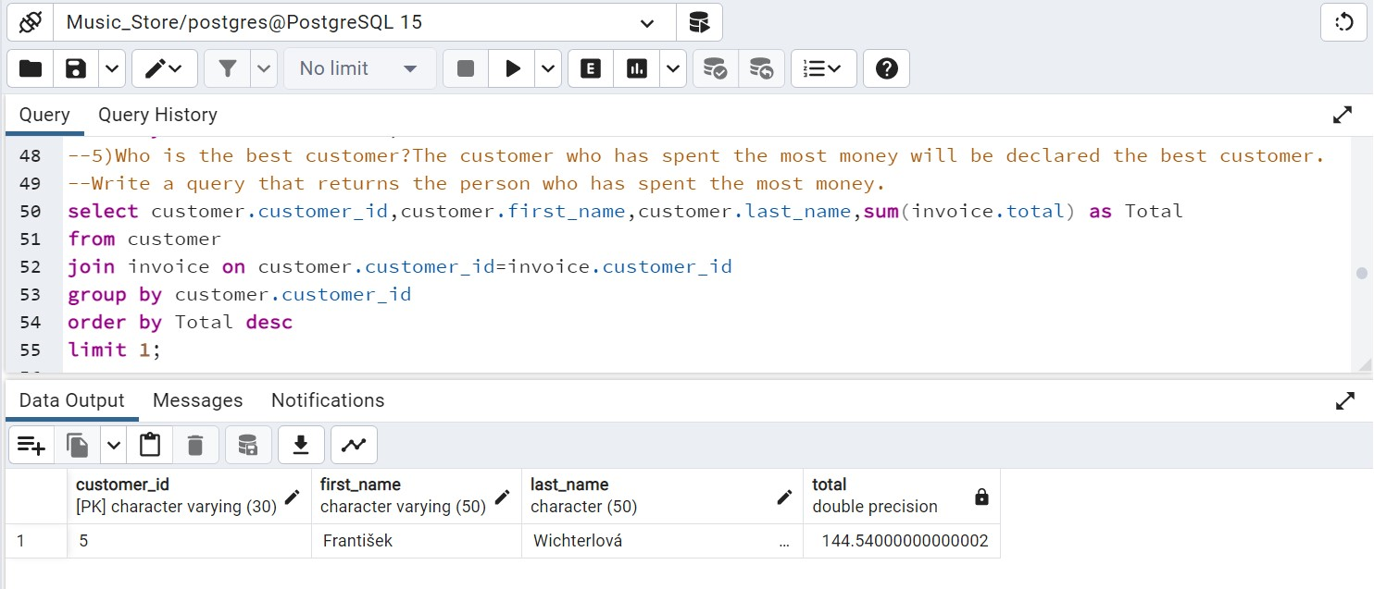

Slide 11
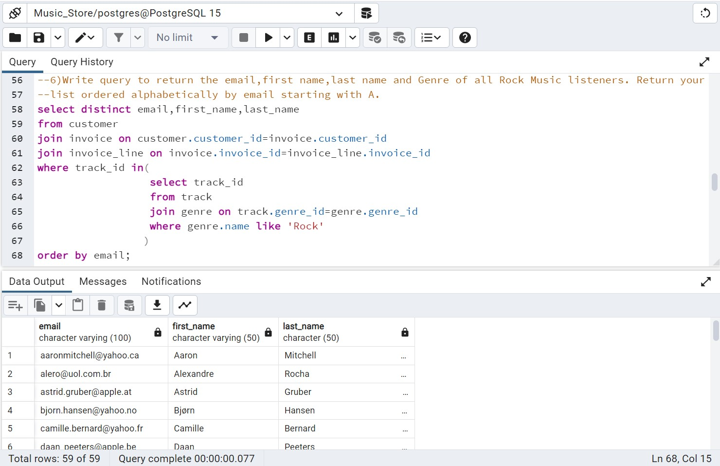

Slide 12
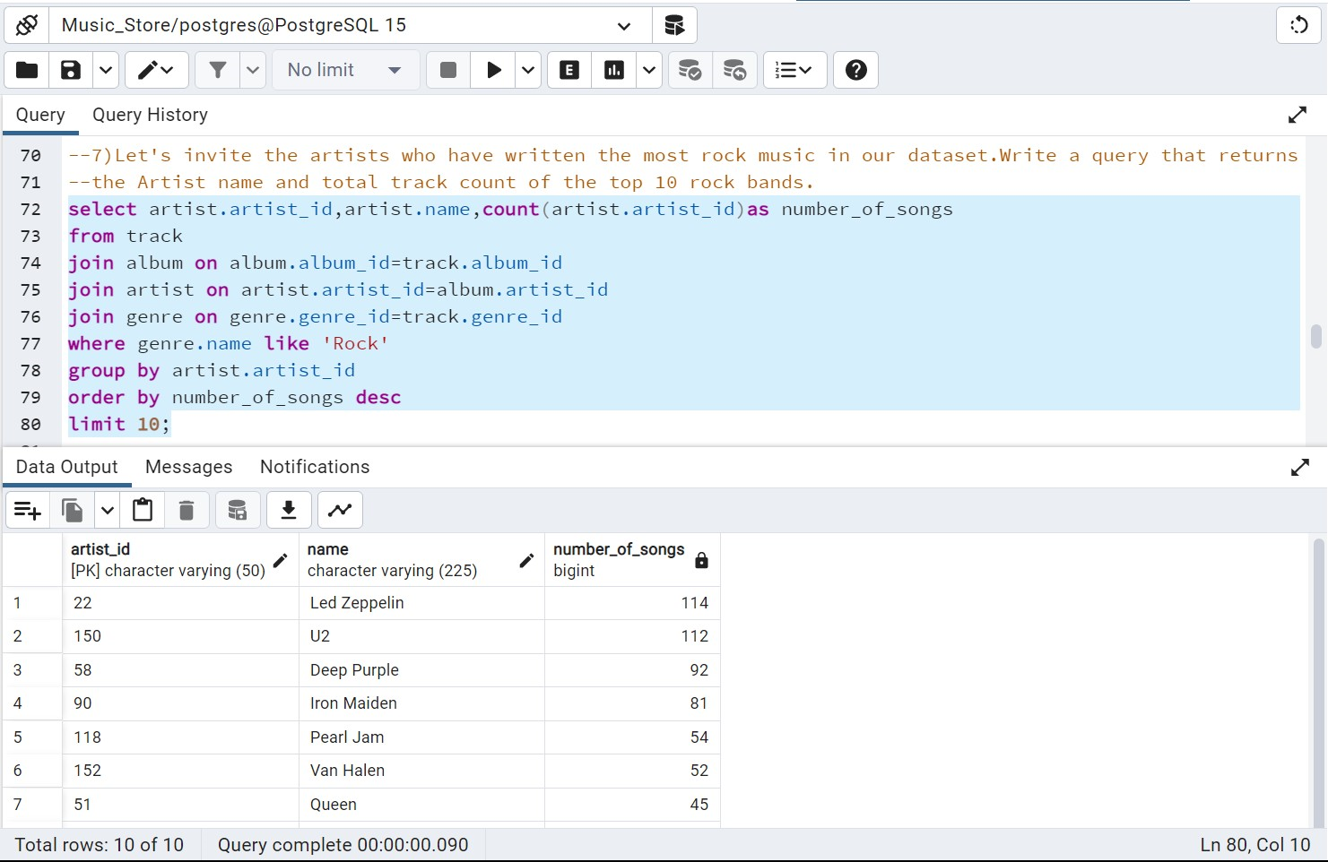

Slide 13
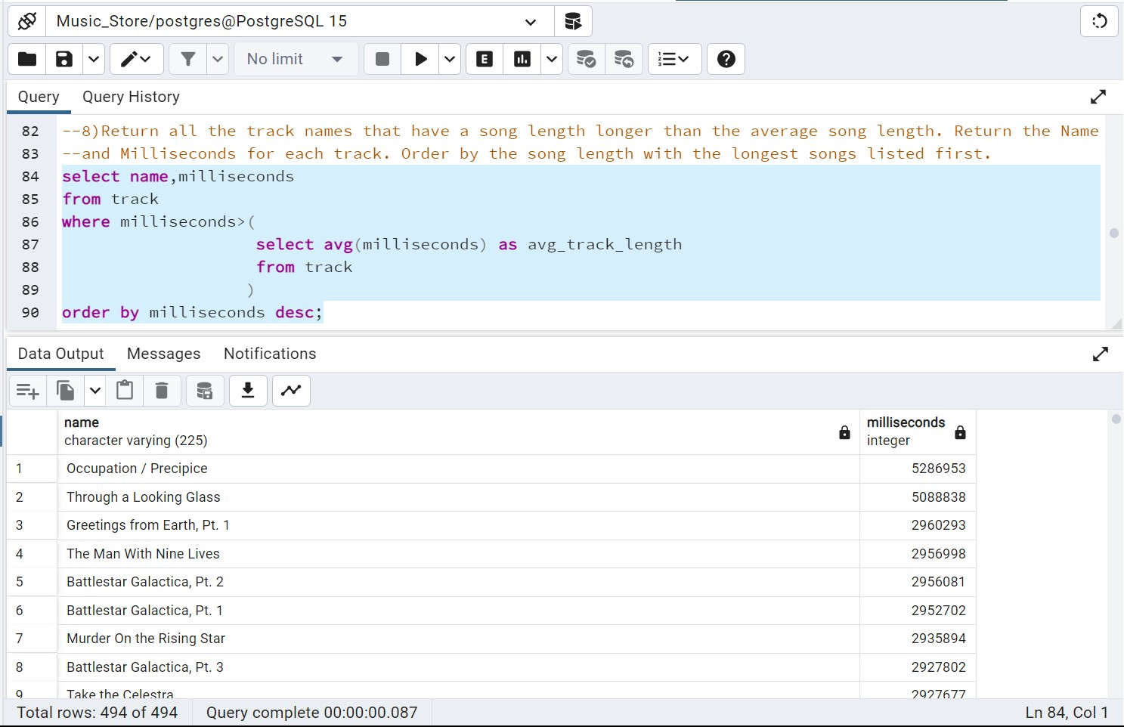

Slide 14
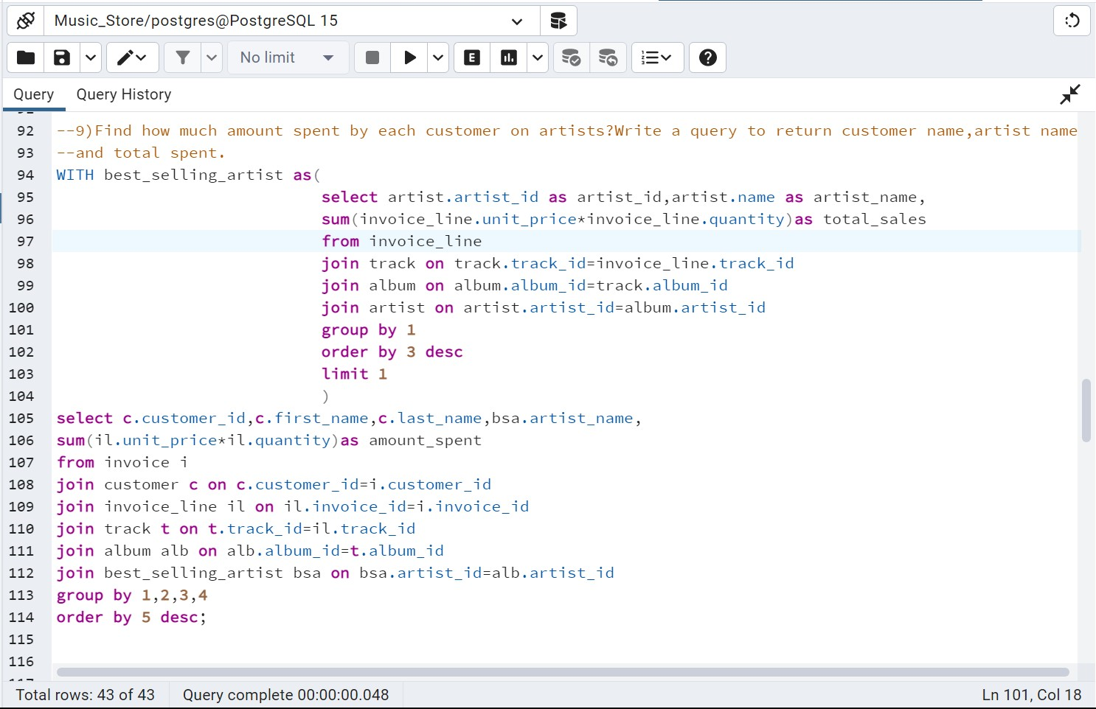

Slide 15
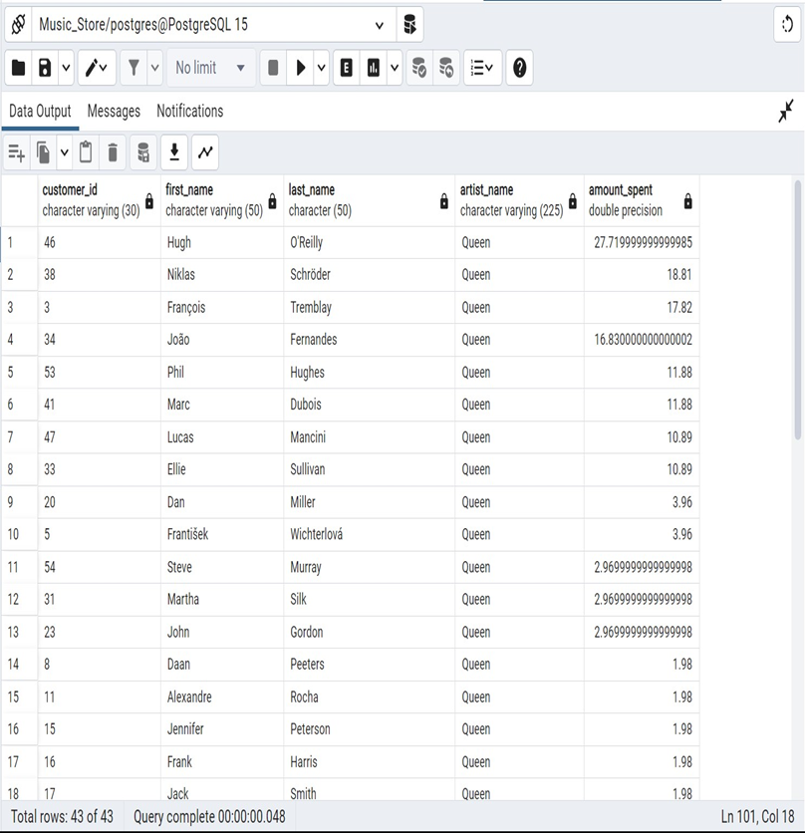

Slide 16
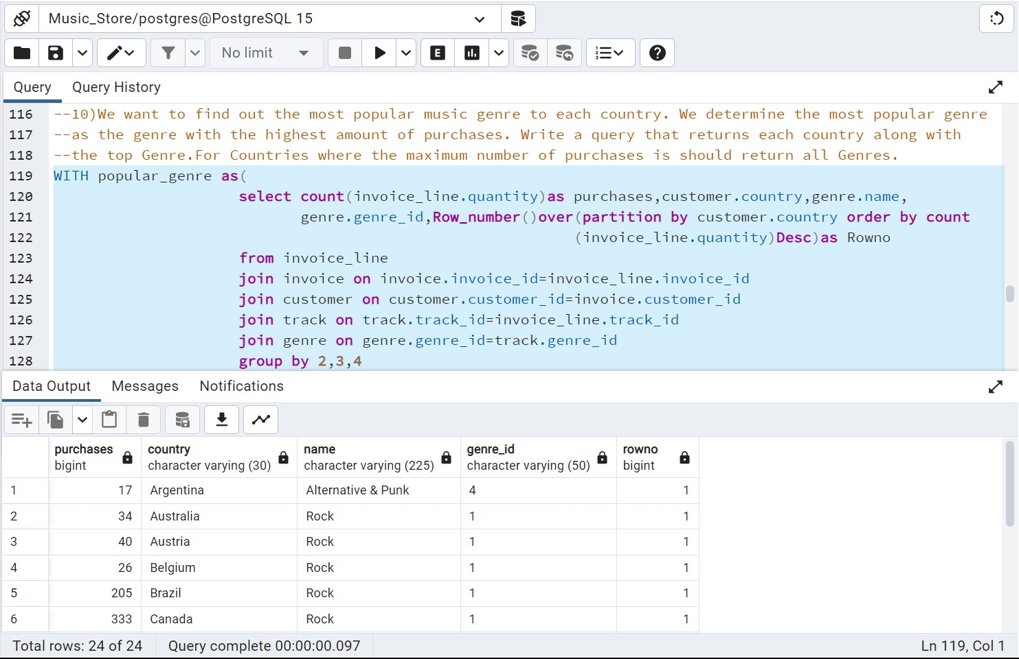

Slide 17
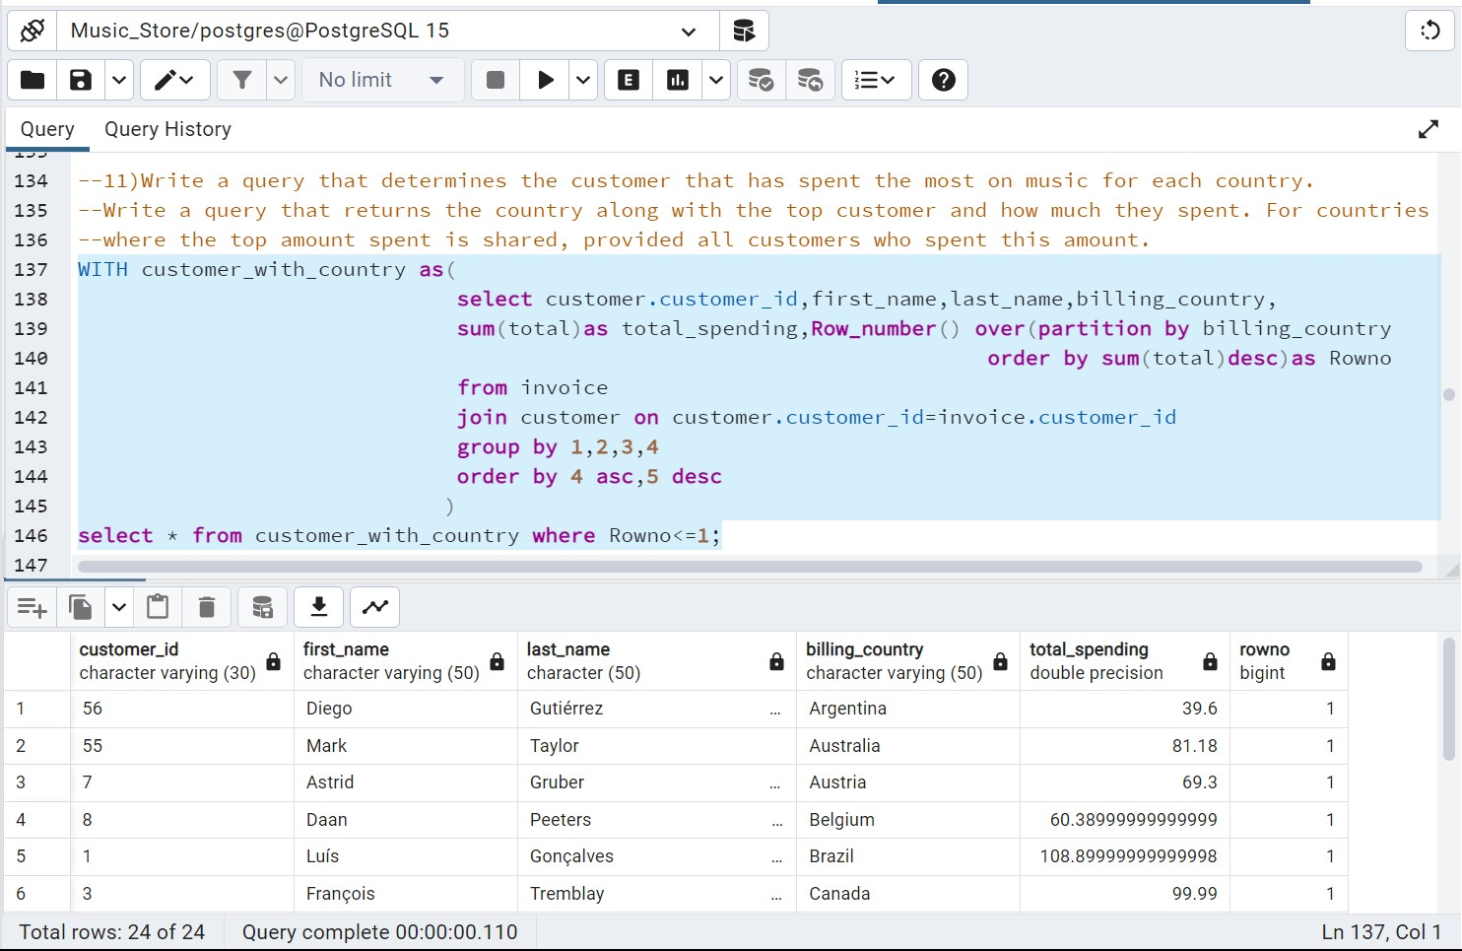

Slide 18
THANK YOU!!

